Slide 1
CS621B/C Spatial Databases
Web-based Mapping
December 11th 2014
Dr. Peter Mooney peter.mooney@nuim.ie

Slide 2
Agenda for today
To go from a blank web-page to a web-page which includes an interactive web-based map
Examples driven lectures

Slide 3
What these lectures WONT do!
We are not trying to build high-end web-pages and web-sites
We are not going to be covering complex interactions including client-server interactions
We are trying to understand the processes around displaying spatial data on a map on a web-page.

Slide 4
Understanding Web Page Structure
<HEAD>
<BODY>

Slide 5
Understanding Web Page Structure
<HEAD>
This is normally where we link to code
and other structures
which add functionality to our web-page
<BODY>
This is “the web” page which
your users will see

Slide 6
Understanding Web Page Structure
<HEAD>
We don't normally do much work in
the <HEAD> of the page
<BODY>
The BODY can be split into separate
“containers” which hold
different components of the page

Slide 7
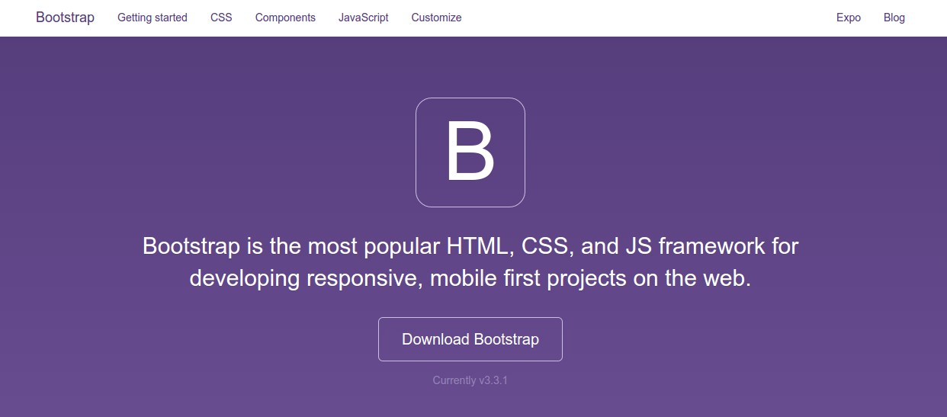
We will use Twitter Bootstrap to help us develop our web-pages

Slide 8
I've downloaded BOOTSTRAP for you already to use today
Inside the folder(s) you have downloaded you will notice a folder called “bootstrap”.
Inside this folder – there are 3 sub folders (CSS, Fonts, JS)
We will need the files inside these folders to build our web-pages today.
In fact we will need additional files to include our mapping functionality also.

Slide 9
What's with the CSS, Fonts and JS folders?
We don't really need to go into much details about what these files are today
But
CSS: This is Cascading Style Sheet and it controls the “look and feel” of your web-page
Fonts: well ... these helps with Bootstrap fonts
JS: For Javascript – this is required to make some functionality provided by Boostrap work

Slide 10
Encapsulation!
The idea behind using a framework such as BOOTSTRAP is that – YOU DON'T WORRY ABOUT CSS, FONTS and JAVASCRIPT
The murky details of these are hidden or encapsulated away!
We will have to work with Javascript later – but that is when we want to add our own functionality which is additional to what Bootstrap gives us

Slide 11
We will need to link to the Bootstrap CSS and JS on every page
This will be done in the <HEAD> section of the webpage
Without this link we will not have a nice responsive web-page.

Slide 12
Bootstrap is “Mobile First”
What does this mean?
Bootstrap has been developed by the people at Twitter to be “responsive across all devices”
This means that if you use Bootstrap (and use it correctly) – then your webpage(s) should look great from small smartphone screens right up to huge screen displays!

Slide 13

After each example – check out the webpage you create on your PC and your smartphone/tablet

Slide 14
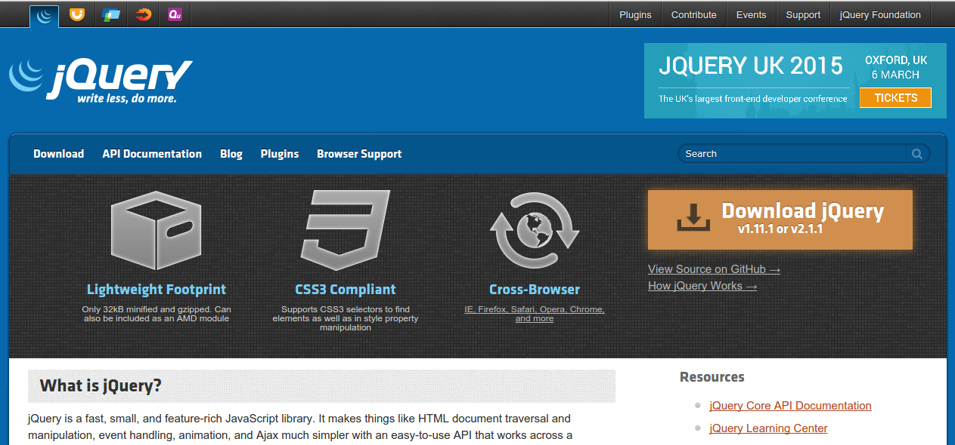
JQuery

Slide 15
What is Jquery?
Jquery is one of the most useful Javascript libraries on the Internet today
You'll see it inside the Jquery folder in the todays download
Like Bootstrap – there is no need to look at it.
But Bootstrap needs Jquery AND our mapping application will also need it.
Suffice to say – Jquery is very important

Slide 16
Let's start building some pages

Slide 17
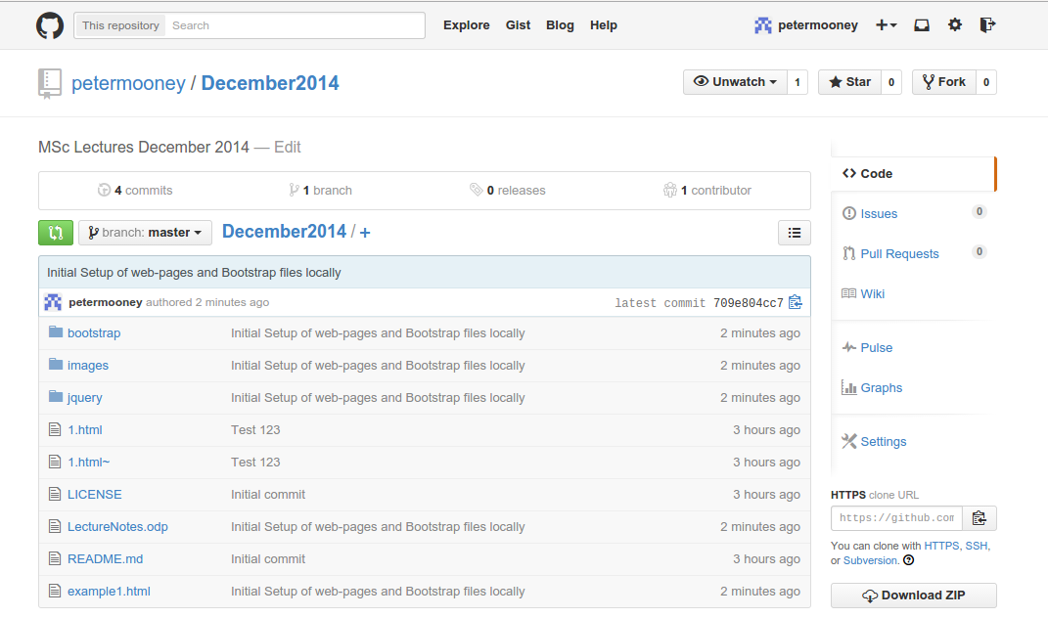
GITHUB Page for today's lectures
https://github.com/petermooney/December2014

Slide 18
You can download as ZIP
https://github.com/petermooney/December2014
Download as ZIP – just unzip to any location on your computer. Do not change or move any of the folders within the extracted zip file

Slide 19
You can always just do git clone
https://github.com/petermooney/December2014
Open a command/terminal prompt
git clone https://github.com/petermooney/December2014.git

Slide 20
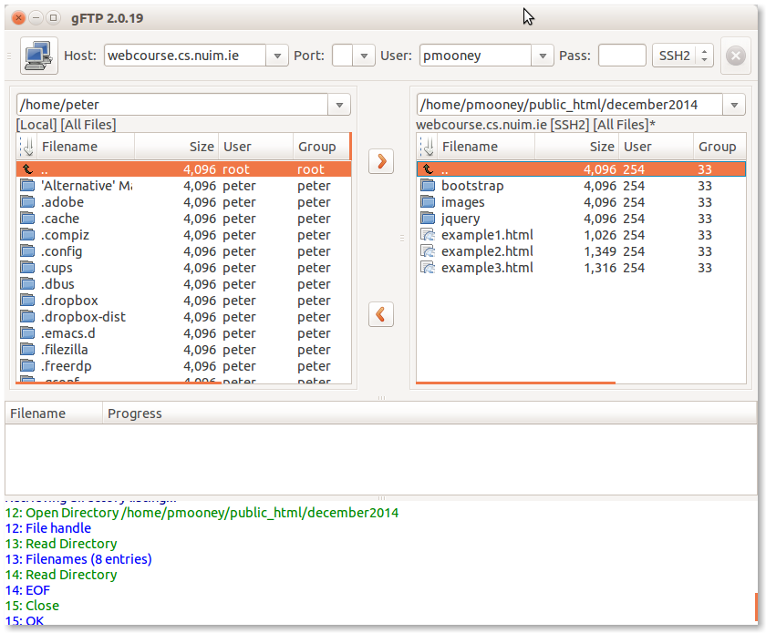
Before we start – let's upload ALL of the folders you see in your download folder to
your WEBCOURSE.CS.NUIM.IE account

Slide 21
What to do next.
Make a new folder (you decide the name) inside the public_html folder of your web-course account.
Your base url will then be
https://webcourse.cs.nuim.ie/~youname/yourfoldername
This is the folder we will use for the rest of the lectures today

Slide 22
All web-pages will have the same code structure today
<html>
<head>
<title> Your page title </title>
Your links to CSS and JS go here
</head>
<body>
Your webpage goes here
</body>
</html>

Slide 23
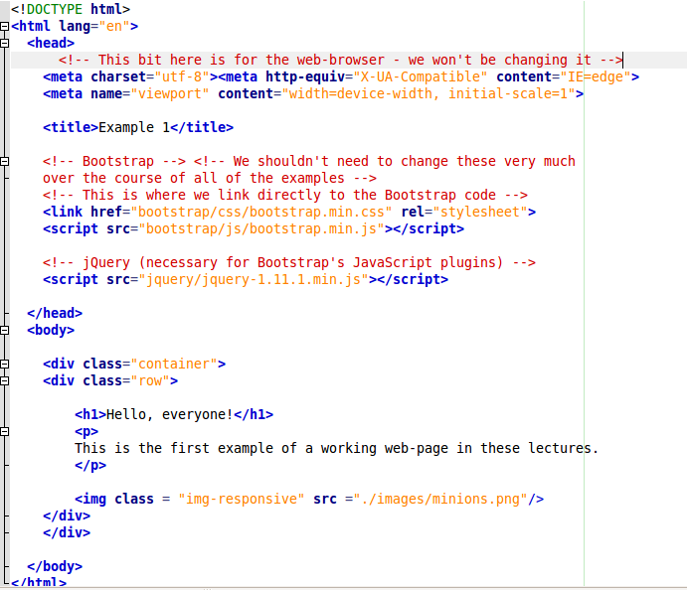
Example1.html

Slide 24
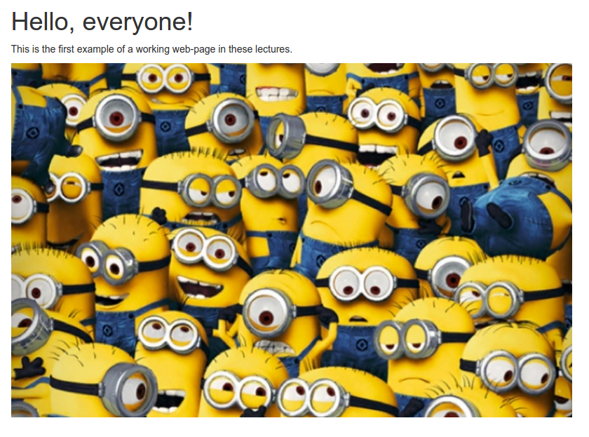
https://webcourse.cs.nuim.ie/~YOURNAME/YOURFOLDER/example1.html

Slide 25
Trying some HTML tags
Let's try to use some basic HTML tags to 'MARKUP' our text
<h1>This is a big heading</h1>
<h2>Second biggest heading</h2>
<h3>, <h4> and <h5>
<p> starts a pargaraph which ends with </p>
<strong> marks bold text</strong>
<em> marks bold text </em>

Slide 26
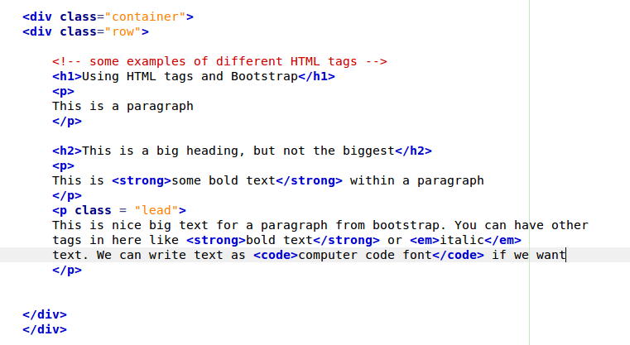
Open up Example2.html and upload to your webcourse folder

Slide 27
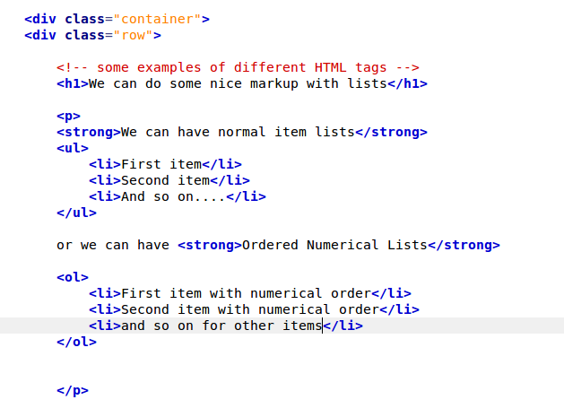
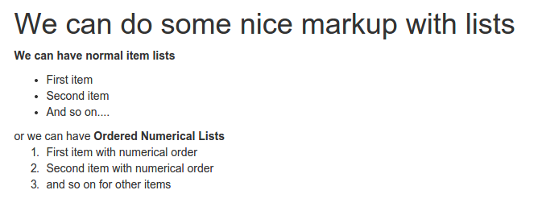
Open up Example3.html and upload to your webcourse folder

Slide 28
Task 1
Create a file called Task1.html – you should copy Example1, example2 or example3 and change their filename – as we need all of the content in the page <head> and <body> structure to be the same.
Create a simple webpage – showing heading tags, paragraphs, lists to outline the your module list, your favourite web apps, anything..
Upload and display on your webcourse folder

Slide 29
Starting mapping
Let's get drawing some maps.
We are going to use the structure of the previous examples as a basis for our maps
To include maps in a web-page we need (1) a container (div) to hold the map and (2) javascript to display and control the map

Slide 30
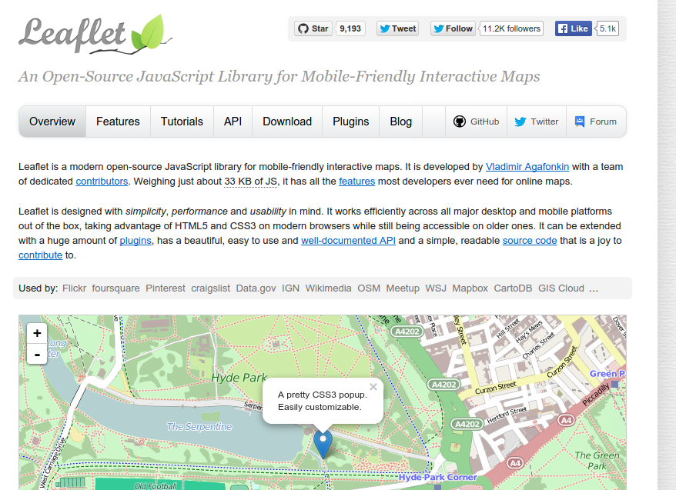
Leaflet

Slide 31
Leaflet is easy to use
There are many similiar javascript libraries for working with maps in web-pages
But Leaflet is a little different
It is very easy to use – very easy to learn – and it is very mobile friendly.
It can handle a lot of the functionality that people require from web-mapping.

Slide 32
Example4.html is the first Leaflet example today
There are a few changes to Example3.html which are visible in Example4.html
These changes reflect the introduction of Leaflet functionality
You'll notice the LEAFLET folder in your downloaded folder for today.
Let's open up Example4.html – and we can talk through what is new.

Slide 33
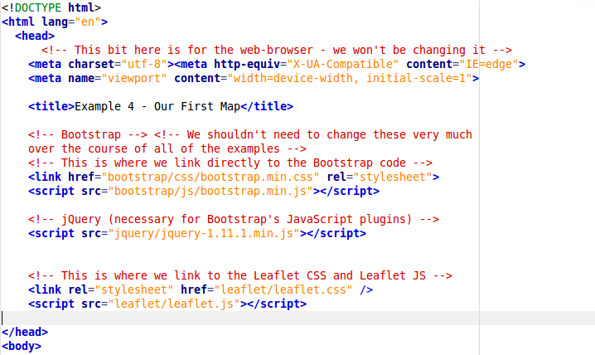
Change 1: We have had to make a direct link to Leaflet's CSS file and Javascript file

Slide 34
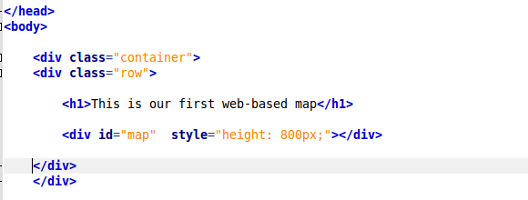
Change 2: We have to create a 'container' for the map
This is the map container – we allow it to have a width of 100% (the full page width) and we set the max height as 800px

Slide 35
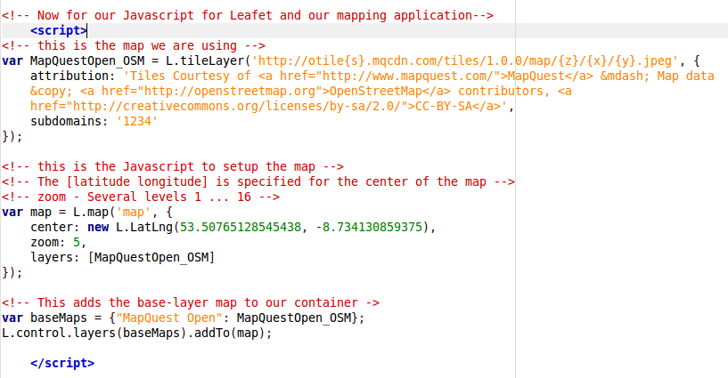
Change 3: The Javascript to operate the map functionality is provided

Slide 36
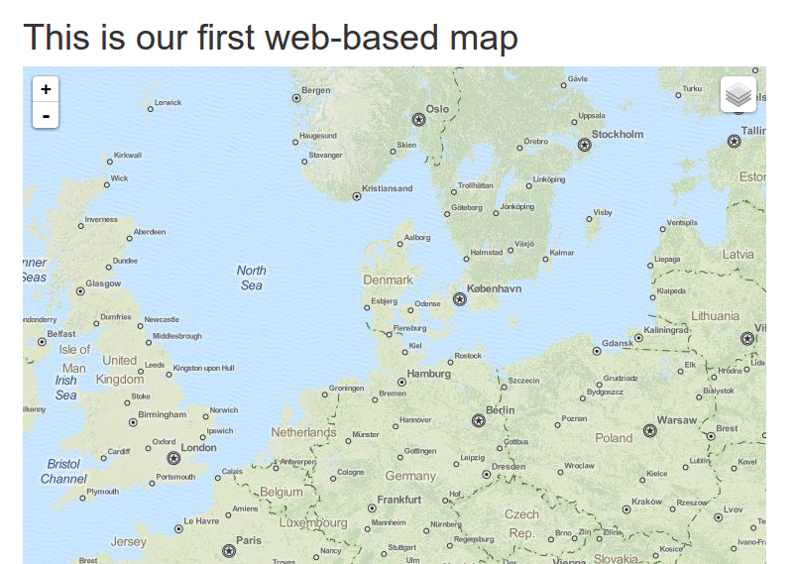
Load up Example4.html to your webcourse folder – you should get output like this.

Slide 37
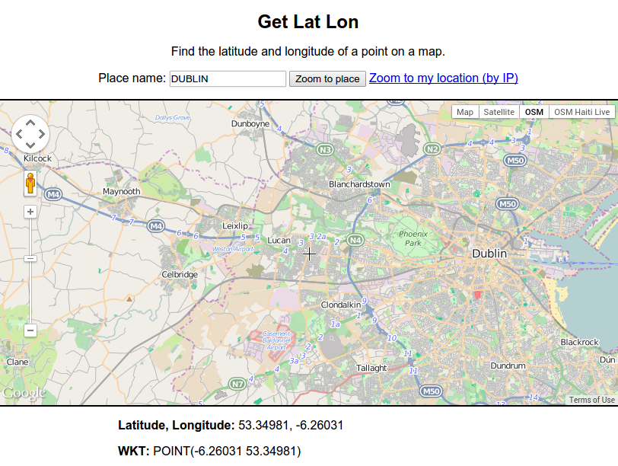
http://dbsgeo.com/latlon/

Slide 38
Task 2:
Take Example4.html and copy and rename to Task2.html
Edit the Javascript for the map – to include a different map center (pick this from Get Lat Lon website)
Change the zoom level – 1 ... 16
Save, upload to webcourse folder and view

Slide 39
Example5.html
Adding markers to the map
We want to use the map to add our own data to – not just display a map canvas.
Example5.html shows how to put markers onto the map

Slide 40
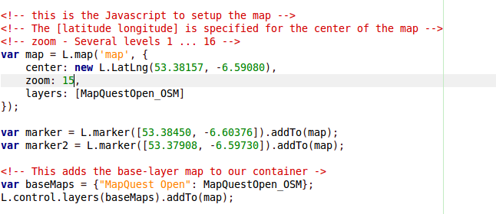
Example5.html
I've changed the center of the map – to the center of the campus – and I've also changed the zoom.
Two markers added to the map

Slide 41
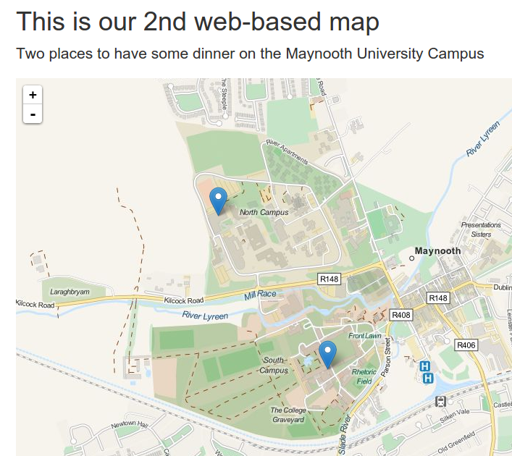
Example5.html

Slide 42
Example6.html – adding popups
In the previous example – the markers didn't actually do anything – they just marked out locations on the map.
In this example – we will supply text which can be shown when you click on the map.
So let's open Example6.html, upload it to your webcourse folder and view it.
Maybe check it out on your smartphone/tablet

Slide 43
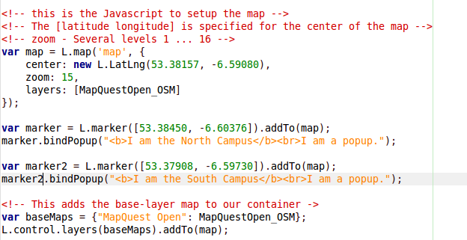
Example6.html – adding popups

Slide 44
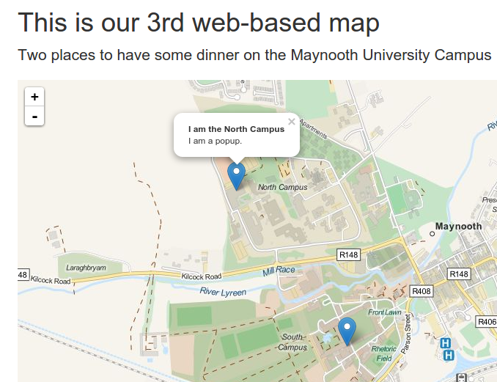
Example6.html Popups

Slide 45
Task 3:
Make a copy of Example6.html
Rename the file as Task3.html
TASK: use the GetLatLon website to find coordinates
Create 4 popups for 4 locations of Olympic Games – center the map appropriately with an appropriate zoom

Slide 46
Example7.html POLYGONS
Up to now ... we have just worked with points on the map
How do we display polygons?
Polygons can be represented in leaflet. Look at Example7.html – upload to web-course and view.

Slide 47
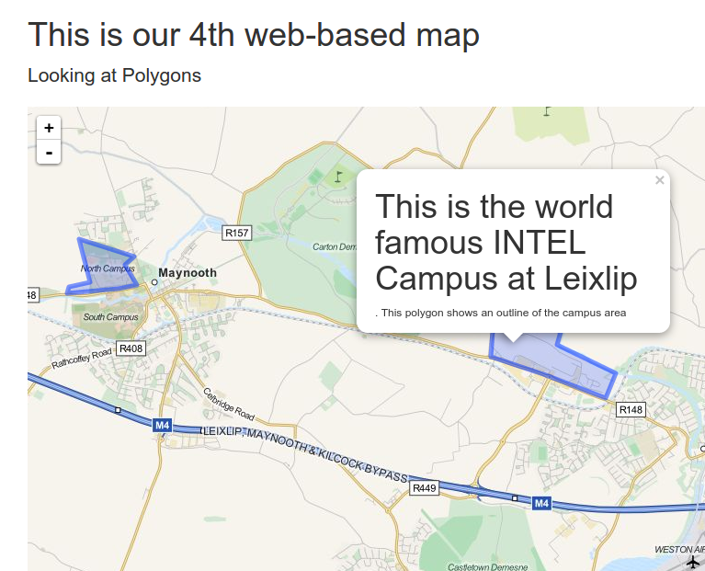
Example 7

Slide 48
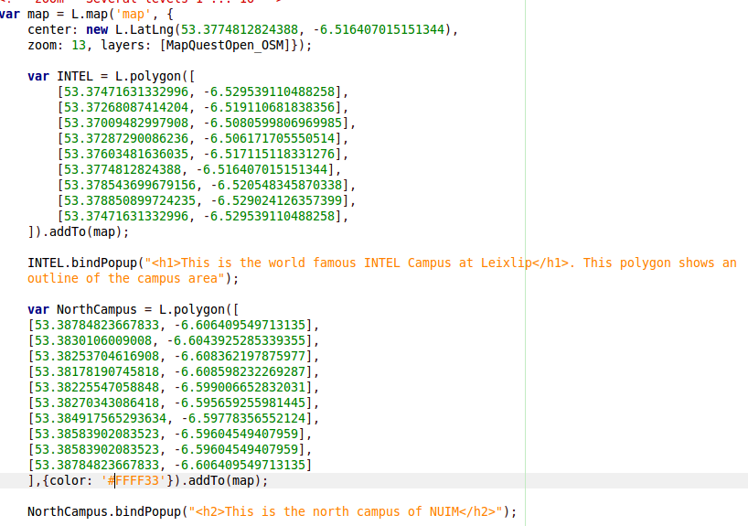

Slide 49
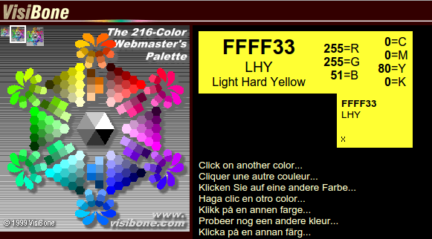
Notice the color value?
This is a color value specified as a HEXIDECIMAL value
We don't need to go into details but this is how colors are represented accurately for web-browser software
https://www.visibone.com/colorlab/

Slide 50
Task 4
For Task 4 – copy example7.html (rename to task4.html)
Use GeoLatLon webpage – to get the coordinates of the south campus – create the south-campus polygon and add to the map. You might need to fix the center of the map and the zoom. You must also add a popup for the south campus polygon. Pick a suitable color for the polygon from Visibone Color Lab

Slide 51
How are the polygons structured?
L.polgyon([
[lat,long],
[lat,long],
etc
......
......
[lat,long] notice no comma
])

Slide 52
Switching Background Layers

Slide 53
Background Layers in Web Maps
Up to this point – we have just used one background layer for all our map examples
This is the called the “BASE LAYER” or “BASE MAP”
In the top right hand corner there is a button icon called the “layer switcher”. This allows us to change the BASE LAYER
In the next example we will add some new base layers

Slide 54
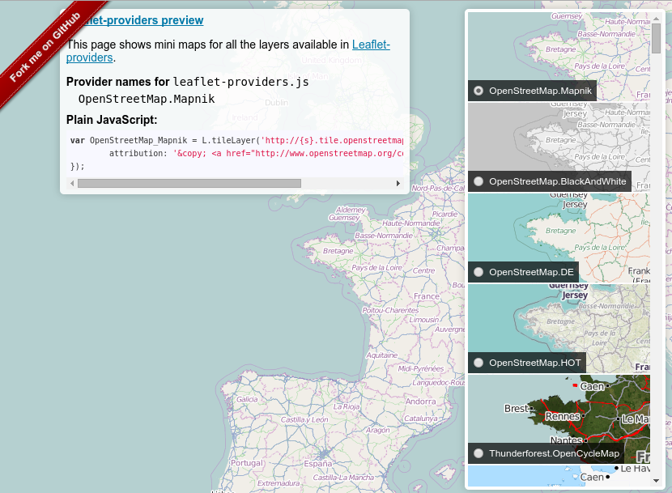
http://leaflet-extras.github.io/leaflet-providers/preview/

Slide 55
Leaflet Providers
The Leaflet Providers page gives us a list of providers of base-layers which we can include in our Javascript code.
You must carefully copy the “Plain Javascript” code from the preview into your Javascript map code.
You can choose as many as you like – but we have to add them to the 'basemaps' variable further down our code.

Slide 56
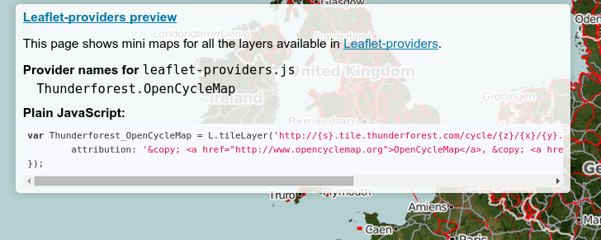
Copying the Plain Javascript
You will need to copy this. Be careful and make sure you copy all of this text – starting at 'var'

Slide 57
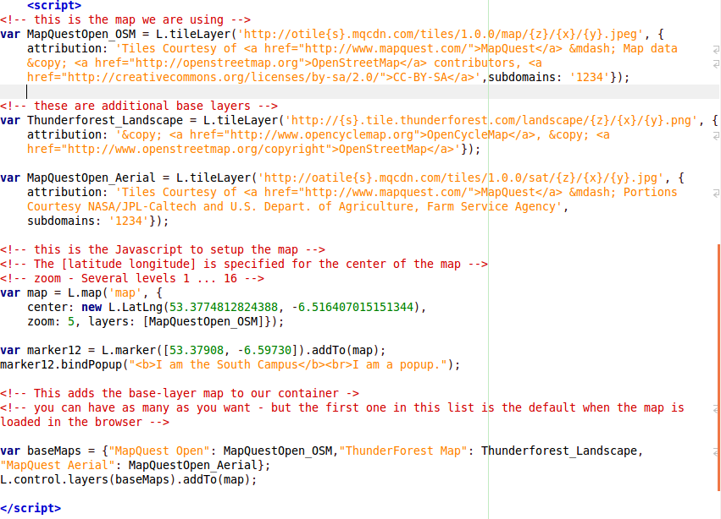
Example8.html – adding baselayers

Slide 58
Task 5: Switching Base Layers
Copy Example8.html and rename to Task5.html
Use http://leaflet-extras.github.io/leaflet-providers/preview/
Choose ANY 3 layers from the Providers page – which must be different to the three layers in Example8.html
Save Task5.html – upload to webcourse – and view the results

Slide 59
Warnings about base-layers
Having lots of choice with base-layers is really fantastic. There seems to be a really vast amount of options.
However....
Not every base layer is suitable for every situation.
You must be careful that the base-layer provides proper/adequate spatial coverage for your application, provides tiles at all zoom levels, is up-to-date, etc.

Slide 60
Where's Google Maps?
We haven't looked at including Google Maps because there are problems with the license to use Google Maps from Leaflet.
Leaflet does provide a plugin – but it shouldn't be used in production environments
Overall – these lectures and my approach is to use completely free and open sources of base-layer mapping and spatial data

Slide 61
OK – Let's see where we are!

Slide 62
We have got some maps working
We can add markers, we can add popups
We can add polygons
However – all this seems pretty cumbersome.
There is a lot of manual work involved
It also mixes our Javascript with our spatial data which is actually very bad practice

Slide 63
Introducing GeoJSON
For the remainder of the lectures we are going to focus on a spatial data format called GeoJSON
You might already be familiar with JSON from programming on the web.
GeoJSON will allow us to store our geographical information in a simple text-based format which can then be natively consumed by web-applications such as Leaflet

Slide 64
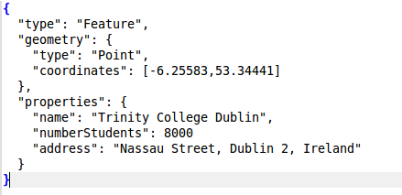
What is GeoJSON?
GeoJSON is a format for encoding a variety of geographic data structures.
It is based on JSON and is human readable
It is navitely consumed by many web applications

Slide 65
What can GeoJSON encode?
GeoJSON can encode POINTS, LINES and POLYGONS
It also allows us to specify PROPERTIES (or attributes/metadata) about spatial objects
This means that we can have a rich store of spatial data within GeoJSON

Slide 66
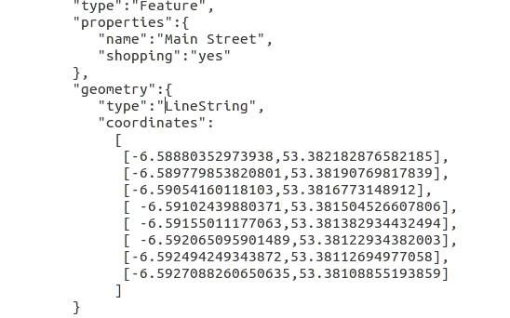
Main Street – Maynooth – as GeoJSON
These are the properties or attributes

Slide 67
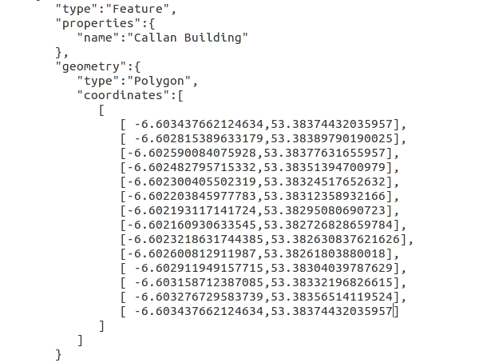
The Callan Building – NUIM Maynooth – as GeoJSON

Slide 68
Some things to note about GeoJSON
FORMATTING – The examples we have just seen are nicely formatted – this is to allow us humans to read it easily – normally GeoJSON removes unnecessary whitespace and line breaks.
SYNTAX – GeoJSON has a VERY STRICT syntax. (curly brackets, quoting, square brackets)
It's always best to use an automated means of creating GeoJSON – NOT MANUALLY

Slide 69
First GeoJSON Example
We need to look at two files – geojson0.html and example1.geojson
Open both of these in your text editor.
Upload both to your webcourse folder and view the geojson0.html file in the browser.
We can see that in the geojson file there are some polygons and a line

Slide 70
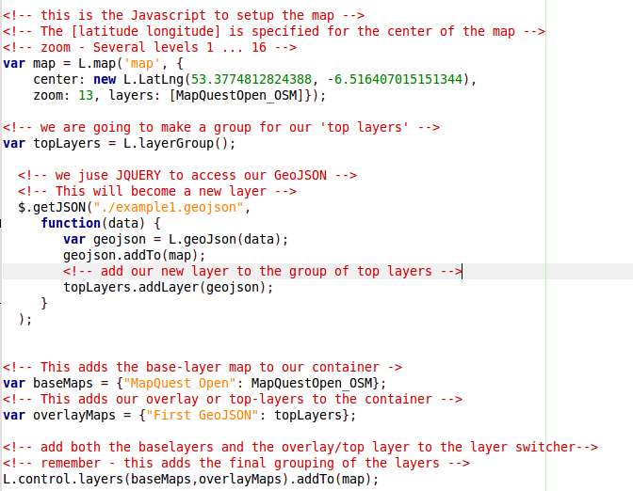
Let's look closer at geojson0.html
1. Create a group to hold the GeoJSON layer in
2. Using Jquery – let's read the geojson in from a file
3. Add the geojson to the layer group
4. Setup the layer switcher (baselayers and overlayers)
5. Setup the layer switcher
This is a VERY important piece of Javascript – in this example we see a simple but fully featured web-based mapping application.

Slide 71
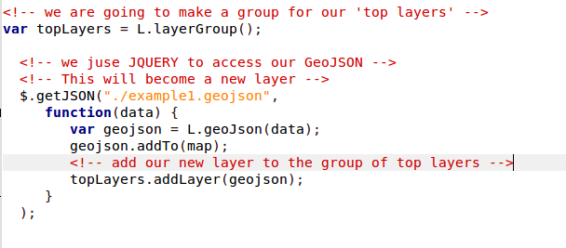
Here is where we use Jquery to fetch the geoJSON
$.getJSON is from Jquery – this greatly simplifies our task. We apply a function then inside $.getJSON to add the geoJSON to the map.

Slide 72
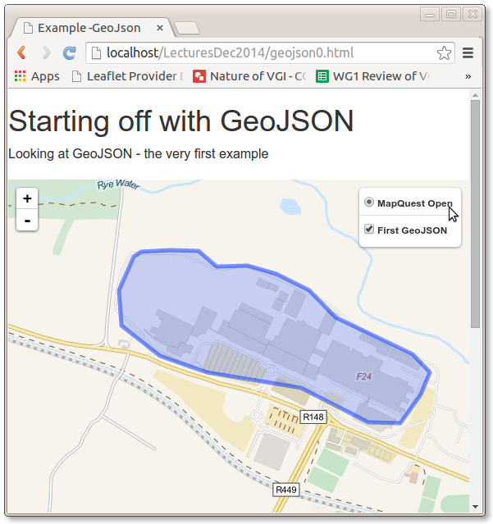
Geojson0.html
Notice how we can easily switch on/off the geoJSON layer?
This concept of switching on and off layers is very important in web-based GIS

Slide 73
Can we get the geoJSON layer to be interactive?
In the earlier examples – we seen that we could attach some information to markers and objects
These are called POPUPS – can we do the same for our geoJSON layer?
Yes we can
But
It's going to need an additional piece of Javascript and an understanding of what “properties” our GeoJSON has

Slide 74
Let's look at geojson1.html
Let's upload it to web-course and see what happens in the browser – be sure to click on the polygons.
Notice that Leaflet knows what the name of each feature is ....
This is because in the geoJSON there is a “properties” value called “name”

Slide 75
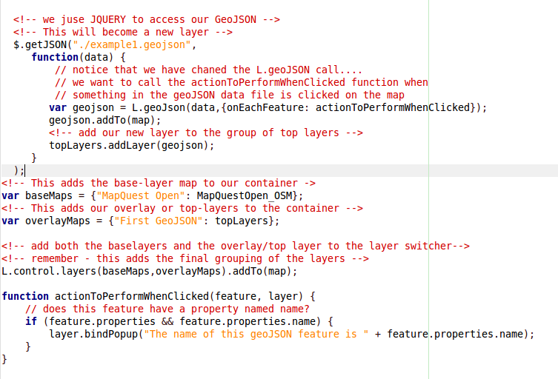
Inside geojson1.html

Slide 76
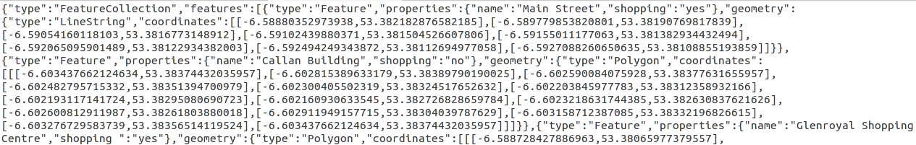
How can we get to know the “properties” in the geoJSON?
You could try to read it from the geoJSON but this could be difficult
Or you could copy/paste to an online validator for geoJSON

Slide 77
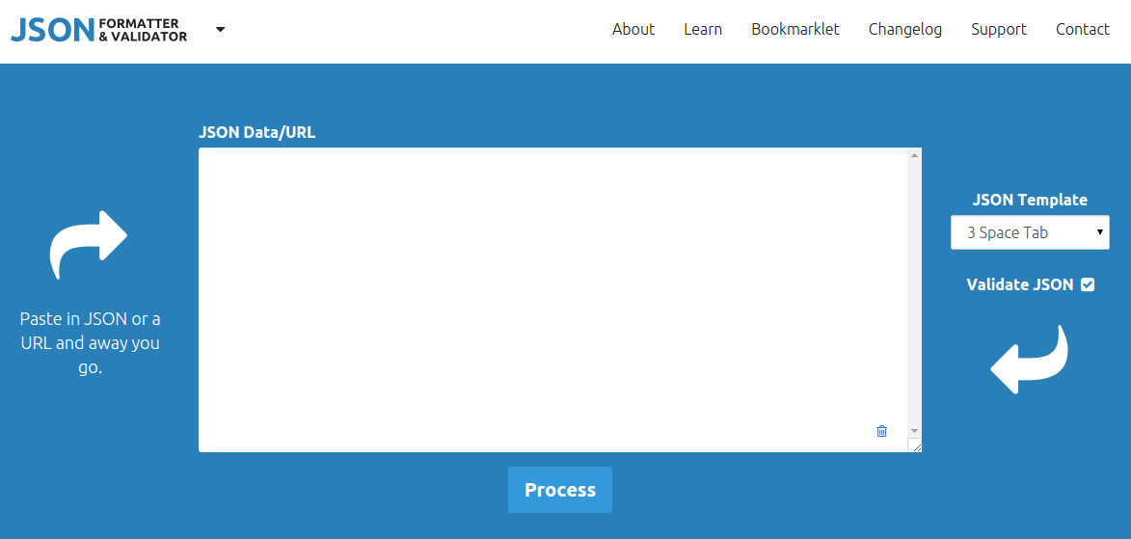
http://jsonformatter.curiousconcept.com

Slide 78
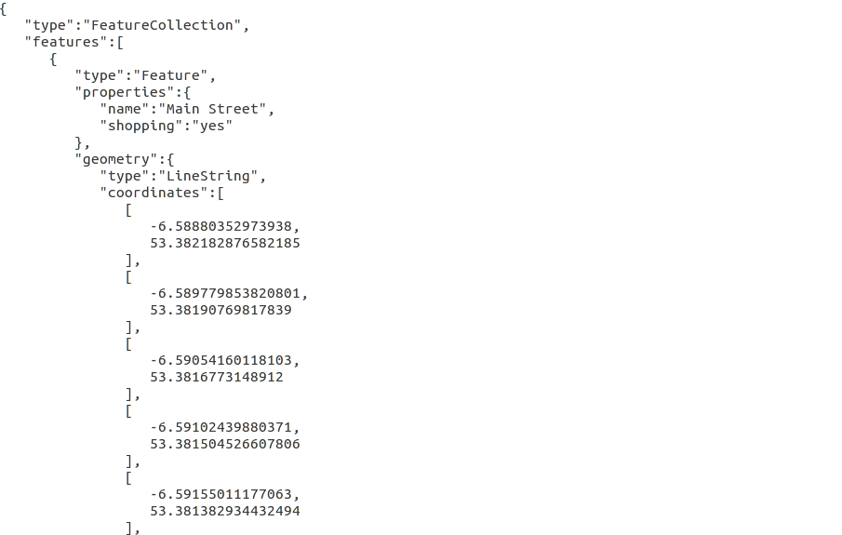
Our formatted geoJSON output is nice for human reading
And we can clearly see the “properties”
Remember – we will have to assume that every object has the same properties – this might not always be the case.
You must always try to understand if this is the case with any geoJSON dataset which you are working with

Slide 79
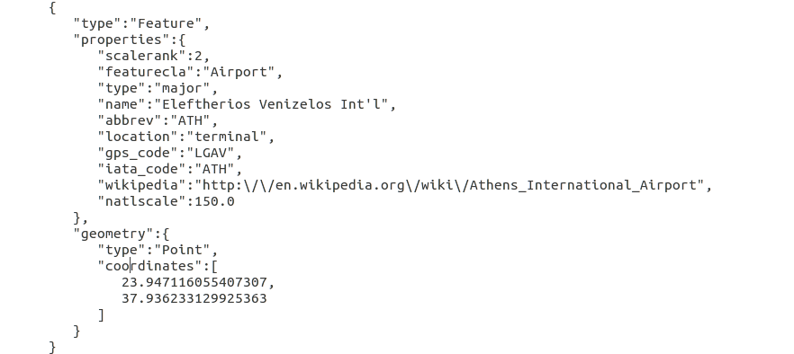
Let's open airports.geojson in your text editors

Slide 80
Let's upload airports.geojson and geojson2.html to webcourse
This is a big geojson dataset
It provides a marker where every airport (of a minimum size/standard) is located
Notice from the source code of geojson2.html how we didn't really have to change much – we just changed the actionToPerformWhenClicked function so that it produced a nicer popup.

Slide 81
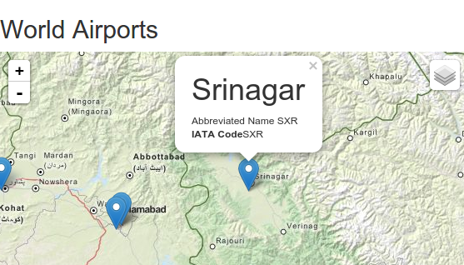
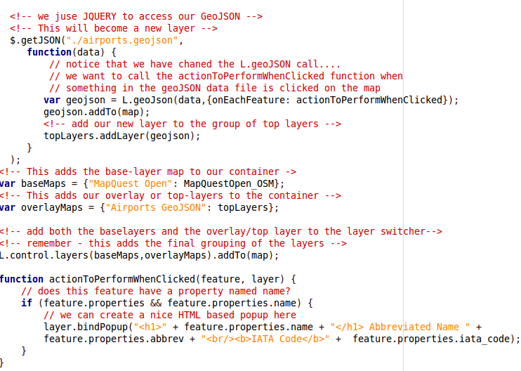

Slide 82
How do I get geoJSON?
There are literally hundreds of ways to get your spatial data in geoJSON
- use a programming language such as PHP
- use a desktop GIS such as QGIS
- use a spatial database such as PostGIS
- download it from a web service/site
- create your own using an interactive tool

Slide 83
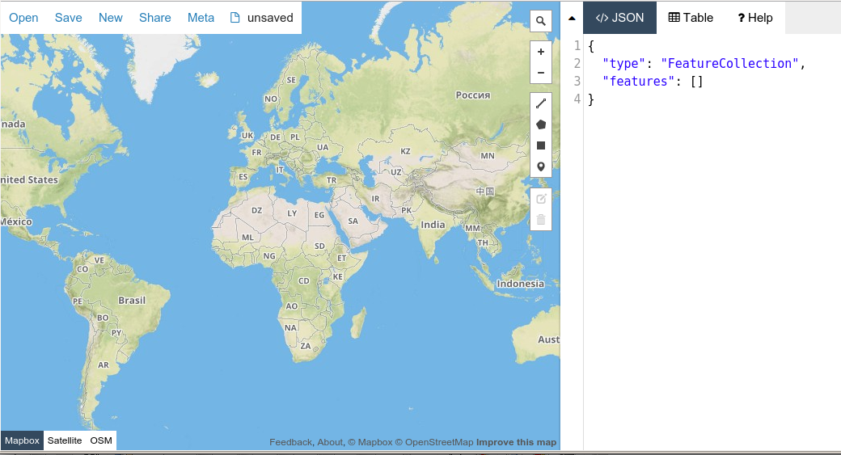
Creating our own geoJSON
http://geojson.io/

Slide 84
Use the geoJSON.io to create some objects on the map
Zoom in to your region of interest
Create an object – make sure that you add some properties or attributes.
Choose “save” -> geoJSON and you can save it to your working folder for today.

Slide 85
Task 6
Copy either geojson1.html or geojson2.html and rename as task6.html
Use geojson.io to create a geojson dataset
Dataset Purpose: The outline of 5 university campuses in Ireland. These outlines should have name, studentPop, cityName as properties. Properties can be just estimates or approximations
The resulting webmap should be appropriately centered and zoomed
Popups should include the three properties named above.

Slide 86
Adding a touch of style to geoJSON
Up to now ... we have just added our geoJSON data to our maps without any consideration of styling or visual properties.
How can we change the visual properties of the objects in a geoJSON dataset?
ANS: We have to use Javascript.

Slide 87
Style Example: geojson3.html
Look at geojson3.html in your text editor.
Change the filename of the geojson file to correspond to the file you created in geojson.io a few minutes ago.
Upload both to webcourse server and view
If we look at the source code – we will see a new piece of Javascript which specifies the style we want to apply to the objects in the geojson file.

Slide 88
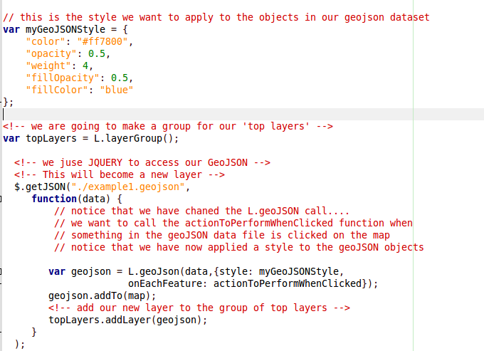
Javascript: applying a style
Color of outline line
Opacity of outline line [0, 1.0]
Thickness (pixels) outline line
What the fille opacity is [0,1.0]
The color which will fill up polygons – we can specify this in HEX or in ordinary color names (check the VISIBONE website)
We then apply our style to this geoJSON layer – by including it in it's properties

Slide 89
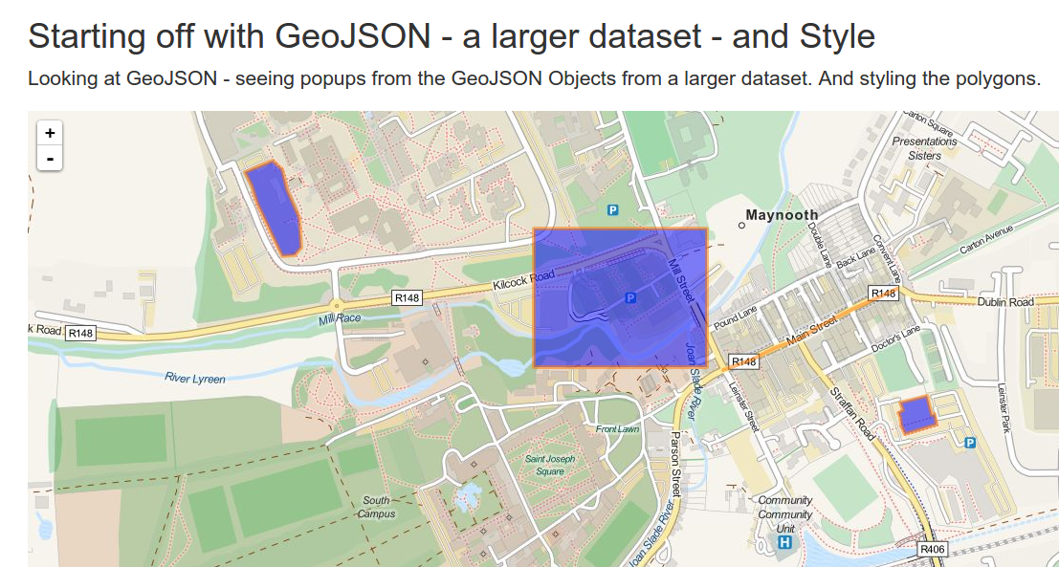
What the styling should look like

Slide 90
Let's experiment with the style(s)
Why not change some of these values and see what effect they have on how your dataset looks?
You will need to make the change in your text editor and then upload to webcourse and view
Note – these styles will not effect MARKERS for points.

Slide 91
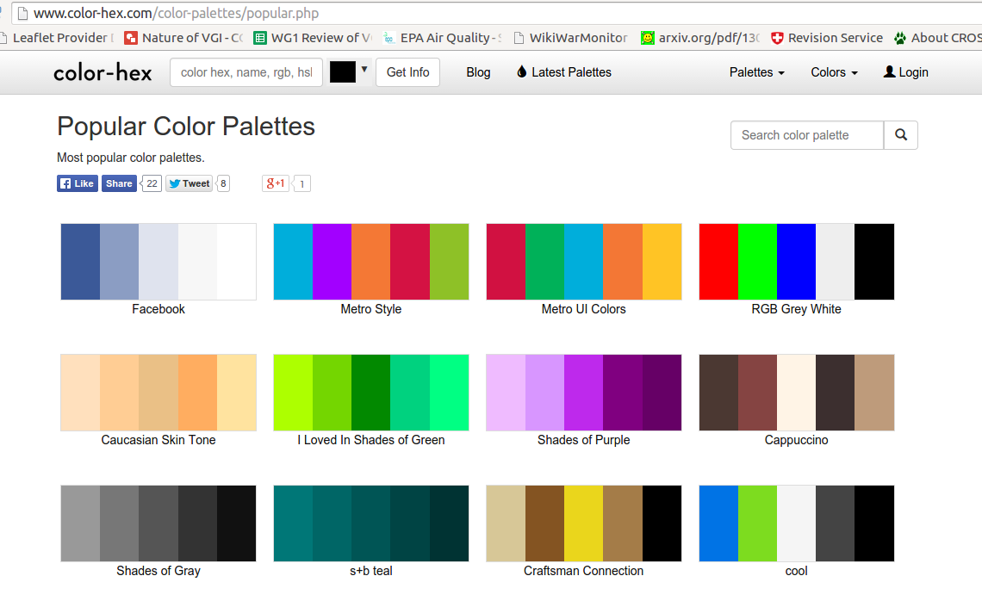
www.color-hex.com/color-palettes/popular.php

Slide 92
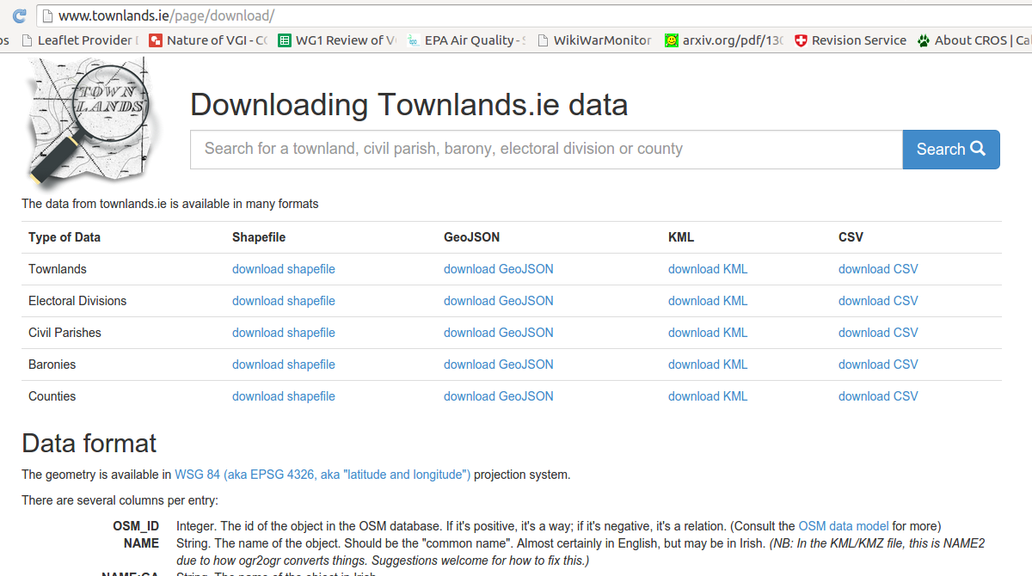
You will need to unzip this download to get the geoJSON
The property name is in CAPITAL LETTERs in the dataset

Slide 93
TASK 7: Styling the counties
Copy geojson3.html and rename as counties.html
YOU MUST HAVE THE COUNTIES GEOJSON DOWNLOADED from townlands.ie
TASK – Display the counties dataset in a web-map. Apply a style which is suitable to this dataset. Change the text on the web-page to reflect the content. Fix the zoom and center. AND – you will need to display the name of the county (remember the property 'name' is in capitals...)

Slide 94
Adding multiple overlay layers
Up to this point we have always just had one overlay layer
We seen ealier where we could have many base layers.
To create a layered effect to web-maps we need to be able to add multiple overlay layers

Slide 95
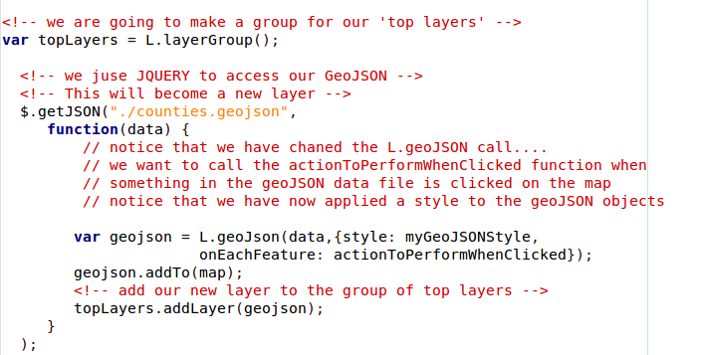
We will need to create a new layerGroup and a new $.getJSON for each layer we want to add
This variable name will have to change – we cannot have the same variable named used twice for different layers

Slide 96
We are also going to have to add the name of this new layerGroup to the layer switcher
A second GeoJSON layer – note the different variable name
One GeoJSON layer

Slide 97
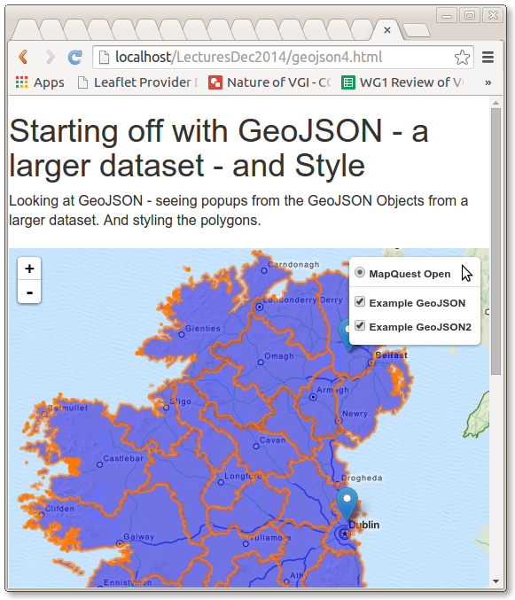

Slide 98
Final Task – Multiple GeoJSON Layers
http://earthquake.usgs.gov/earthquakes/feed/v1.0/geojson.php
We can download some geoJSON data from the USGS Earthquake monitoring programme.

Slide 99
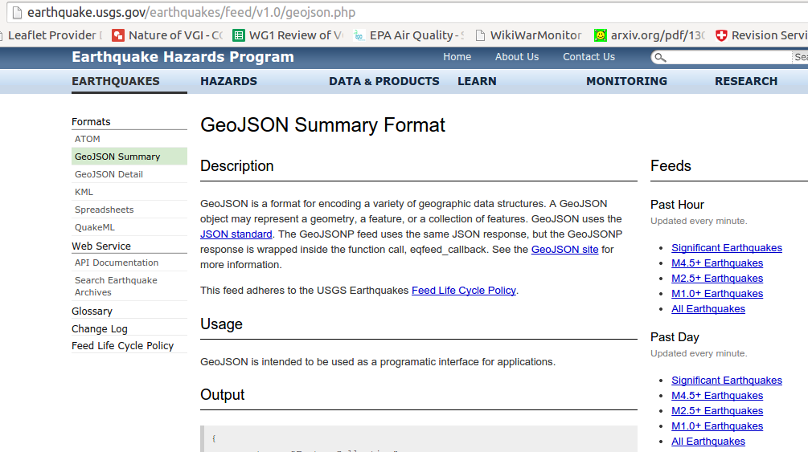
Final Task – Multiple GeoJSON Layers
http://earthquake.usgs.gov/earthquakes/feed/v1.0/geojson.php
We can download some geoJSON data from the USGS Earthquake monitoring programme.

Slide 100
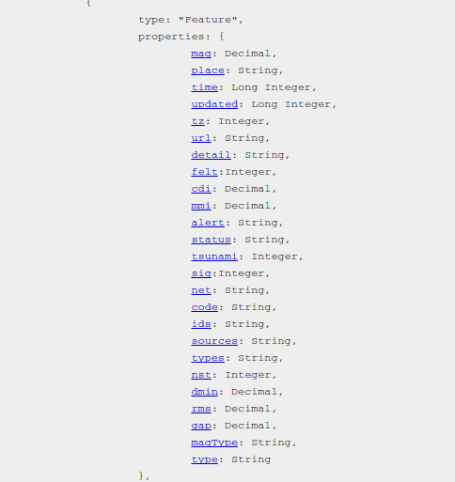
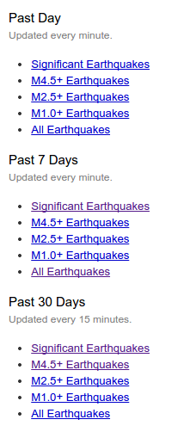
Properties for all of the Earthquake datasets

Slide 101
Final Task: Create multiple overlay layers with style and popup content
Copy geojson3.html and rename as multiple.html
Download ANY 2 of the USGS earthquake monitoring geojson datasets
Create TWO overlay layers ....
No style is necessary for markers
Create an appropriate popup for each of the datasets including at least TWO of the properties in the dataset
Center and zoom the map appropriately.

Slide 102
Can we have different styles for different layers of geoJSON?
Yes – for every layer – we can have a different style (color, line-thickness, etc)
It's up to you to decide what the most appropriate colours are etc.

Slide 103
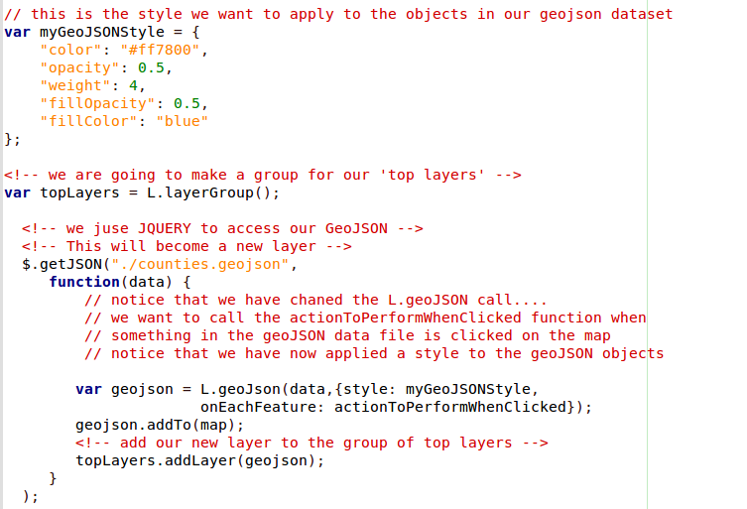
Can we have different styles for different layers of geoJSON?
We can define as many styles as we like – just use the same structure as myGeoJSONStyle
You'll have to call it a different name to this.
And you'll have to change it down when you load the geoJSON
L.geoJSON( )

Slide 104
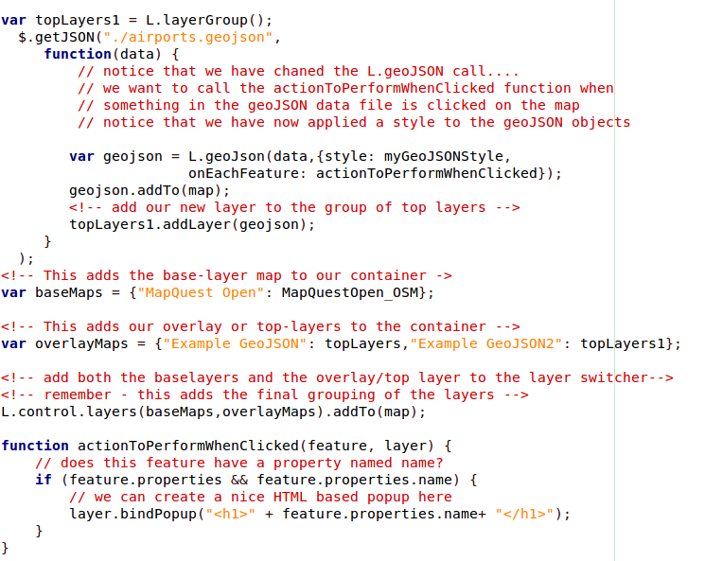
Can we have different popups for different layers of geoJSON?
We will need to have different actionToPerformWhenClicked functions if we want different popups for different layers
You will have to copy this function and change the name – you can change it to any name (no spaces)

Slide 105
So for multiple overlays you should always have the following for each layer
A unique name for
var topLayers = L.layerGroup();
A unique name for
var myGeoJSONStyle = {};
The $.getJSON call – don't forget to match the variable names at addLayer(). And don't forget to include the variable name for the style
Your popup content: you'll need to specify the correct function onEachFeature: actionToPerformWhenClicked
Add your layer to the var overlayMaps grouping.

Slide 106
Assignment

Slide 107
The End

